Slide 1
Deep Learning Models and Applications

Slide 2
Agenda
Deep Learning models
Restricted Boltzman Machines (RBM)
Deep Belief Networks (DBN)
Autoencoders
Convolutional Neural Networks (CNN)
Recurrent Neural Networks (RNN)
Long Short Term Memory (LSTM) models
Example applications of Deep Learning
Further viewing and reading links

Slide 3
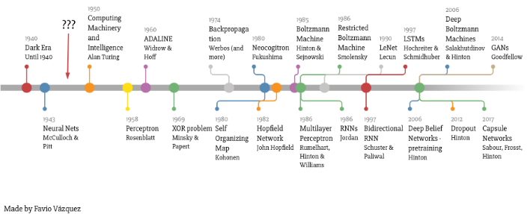
Deep Learning Timeline
Source: A Weird Introduction to Deep Learning by Favio Vasquez. https://www.kdnuggets.com/2018/03/weird-introduction-deep-learning.html

Slide 4
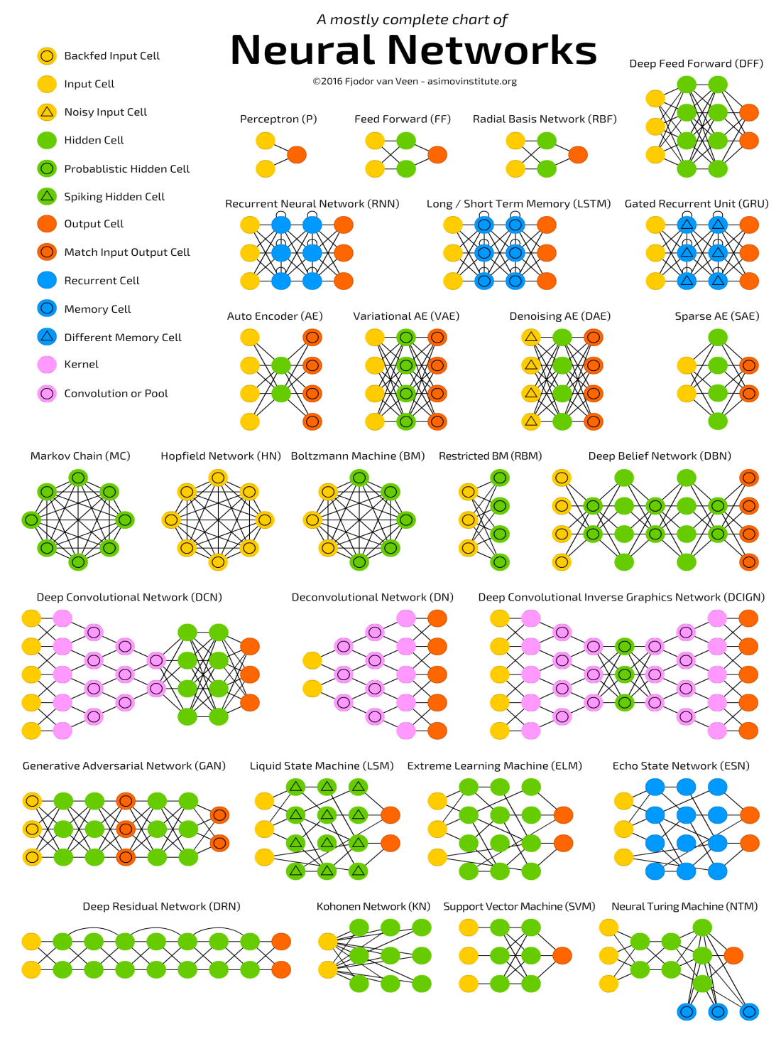
Neural Networks Zoo
Source: The Neural Network Zoo,
http://www.asimovinstitute.org/neural-network-zoo/

Slide 5
Deep Learning models and applications:
Restricted Boltzman machines (RBM)
Deep belief networks (DBN)
Autoencoders
Convolutional networks (CNN)
Recurrent nets (RNN)
Long Short Term Memory (LSTM)

Slide 6
Deep Learning models:
Restricted Boltzman Machines (RBM)
Geoff Hinton
Reconstructs the inputs from a two layer network
No labeling of the inputs; unsupervised
Multiple passes, adjusting weights
Feature extraction or classification is the key
Works with Deep Belief Networks
Source: Restricted Boltzmann Machines - Ep. 6 (Deep Learning SIMPLIFIED), https://www.youtube.com/watch?v=puux7KZQfsE&t=4s

Slide 7
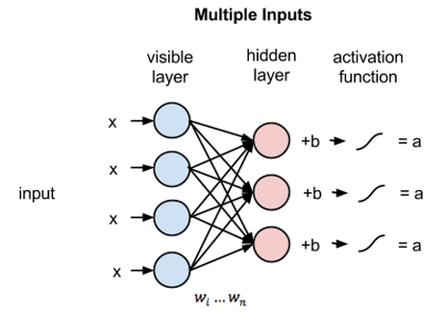
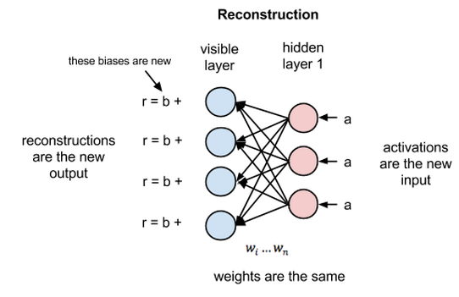
Deep Learning models: RBM
Source: A beginner’s tutorial for Restricted Boltzmann Machines, https://deeplearning4j.org/restrictedboltzmannmachine

Slide 8
Deep Learning models:
Deep Belief Networks (DBN)
Geoff Hinton developed
Viewed as a stack of RBM’s
Similar in structure to MLP
Different training method is key
Each layer is trained separately
Output from one layer the input to next
Used for image recognition
Only needs a small labeled data set after training
NOTE: for a very straightforward illustration of the process of training a DBN,
see these two videos: Part 1 and Part 2

Slide 9
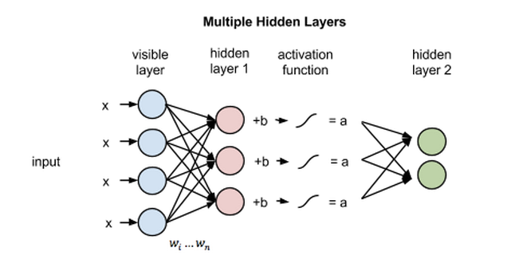
Deep Learning models: DBN
Source: A beginner’s tutorial for Restricted Boltzmann Machines, https://deeplearning4j.org/restrictedboltzmannmachine

Slide 10
Deep Learning models: Autoencoder
Autoencoders
Several types (variational, de-noising)
Feature extractors
Unlabeled images are reconstructed
Dimensionality reduction is the key
Each layer “learns” a more compact representation of the previous layer (ex., a 28x28 pixel image can be compressed into 30 numbers while retaining good fidelity)
Good for: image search, data compression, denoising images, creating new images
Source: https://deeplearning4j.org/deepautoencoder

Slide 11
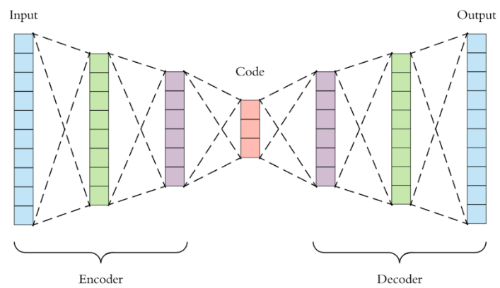
Deep Learning models: Autoencoder
Autoencoders
Similar to DBN
Unsupervised data used - data specific
Hidden layer is the key – supplies information compressed to a lower density (dimensionality reduction)
Source: Applied Deep Learning – Part 3: Autoencoders, https://towardsdatascience.com/applied-deep-learning-part-3-autoencoders-1c083af4d798

Slide 12
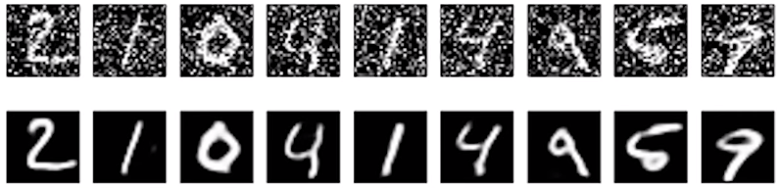
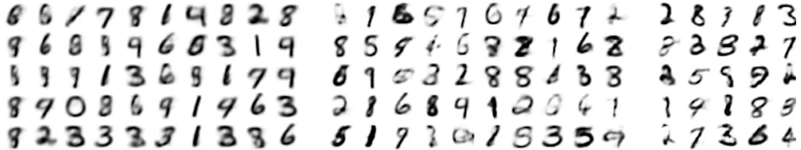
Deep Learning models: Autoencoder
Useful for:
Image compression
Denoising autoencoders – remove the “noise” in images
Variational autoencoders – can draw new images
Source: What is an Autoencoder ? https://www.youtube.com/watch?v=Rdpbnd0pCiI

Slide 13
Deep Learning models:
Convolutional Neural Net (CNN)
Yann Lacun developed
Every input image is an array of pixels
Used by Facebook for image recognition
Supervised learning with labeled images
Several different components:
Convolutional layer
Relu layer
Pooling layer
Fully connected layer

Slide 14
Deep Learning models: CNN
Convolution layer: extracts features from the input image, using filters (which can vary in number, depth, stride, and padding).
Rectified Linear Unit layer (ReLU): ReLU is applied per pixel and replaces all negative pixel values in the feature map by zero. The purpose of ReLU is to introduce non-linearity.
Pooling step: Spatial Pooling (also called subsampling or downsampling) reduces the dimensionality of each feature map but retains the most important information. Takes largest element from the ReLU.
Fully connected layer: The purpose of the Fully Connected layer is to use these features for classifying the input image into various classes based on the training dataset. The sum of output probabilities from the Fully Connected Layer is 1. This is ensured by using the Softmax as the activation function in the output layer of the Fully Connected Layer.
Source: An Intuitive Explanation of Convolutional Neural Networks, https://ujjwalkarn.me/2016/08/11/intuitive-explanation-convnets/

Slide 15
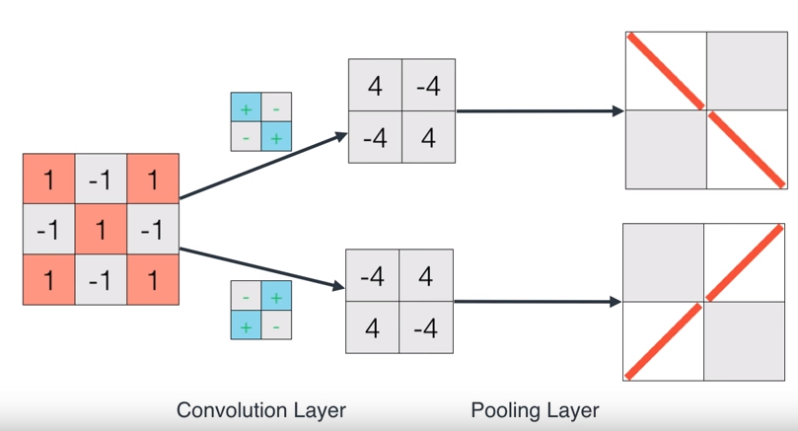
Deep Learning models:
Source: A friendly introduction to Convolutional Neural Networks and Image Recognition,
https://www.youtube.com/watch?v=2-Ol7ZB0MmU&t=317s

Slide 16
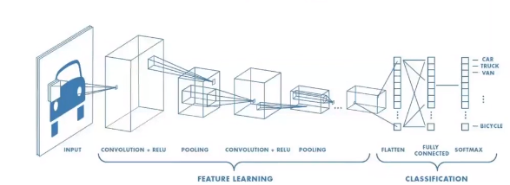
Deep Learning models: CNN
Source: An Intuitive Explanation of Convolutional Neural Networks, https://ujjwalkarn.me/2016/08/11/intuitive-explanation-convnets/

Slide 17
Deep Learning models:
Recurrent Neural Nets (RNN)
Developed by Schmidhuber and Hockreiter
Patterns in data change with time
RNNs are called recurrent because they perform the same task for every element of a sequence, with the output being depended on the previous computations
Unfolded (after complete input) into results (machine translation, image captioning, documentation, supply chain planning)
Can be stacked, but training more difficult
Source: Recurrent neural networks tutorial, part 1: http://www.wildml.com/2015/09/recurrent-neural-networks-tutorial-part-1-introduction-to-rnns/

Slide 18
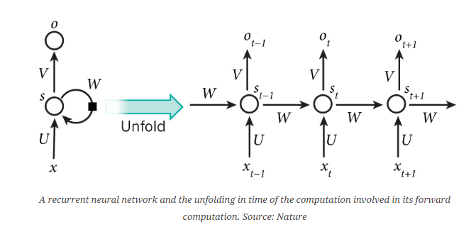
Deep Learning models:
Recurrent Neural Nets (RNN)
Good for Natural Language Processing (NLP) problems. Given a sequence of words we want to predict the probability of each word given the previous words.
Unfolded (after complete input) into results (machine translation, image captioning, documentation, supply chain planning)
Source: Recurrent neural networks tutorial, part 1: http://www.wildml.com/2015/09/recurrent-neural-networks-tutorial-part-1-introduction-to-rnns/

Slide 19
Deep Learning models:
Long Short Term Memory (LSTM)
Special form of RNN which 0vercomes a weakness with RNN by keeping some of the “important” information
LSTMs do not manipulate the entire information but rather modify them slightly, they are able to forget and remember things selectively.
Add “content” to NLP
Source: Essentials of Deep Learning : Introduction to Long Short Term Memory, https://www.analyticsvidhya.com/blog/2017/12/fundamentals-of-deep-learning-introduction-to-lstm/?

Slide 20
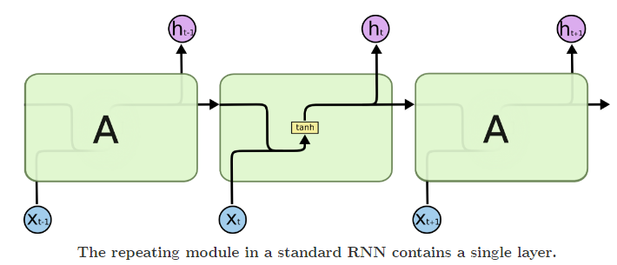
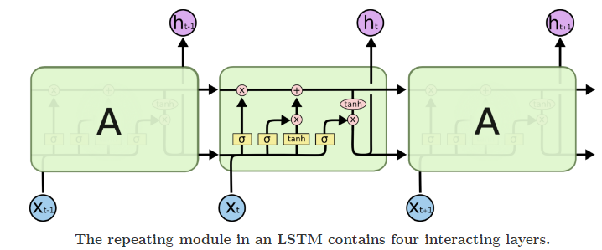
Deep Learning models:
Long Short Term Memory architecture.
Source: Understanding LSTM Networks, http://colah.github.io/posts/2015-08-Understanding-LSTMs/

Slide 21
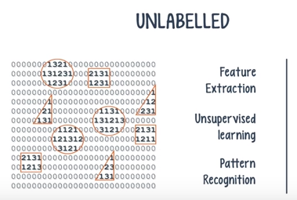
Deep Learning models: when to use which one
Unsupervised learning
Extract patterns
Restricted Boltzman machine (RBM)
Autoencoder
Source: Your choice of Deep Net - Ep. 4 (Deep Learning SIMPLIFIED), https://www.youtube.com/watch?v=JjZDoojyzXQ&t=2s

Slide 22
Deep Learning models: when to use which one
Labeled data
Building a classifier
Text Processing
Sentiment analysis
Parsing
Named entity recognition
Recurrent Neural Network (RNN)
Long Short Term Memory (LSTM)
Source: Your choice of Deep Net - Ep. 4 (Deep Learning SIMPLIFIED), https://www.youtube.com/watch?v=JjZDoojyzXQ&t=2s

Slide 23
Deep Learning models: when to use which one
Labeled data
Building a classifier
Image recognition
Convolutional Net (CNN)
Deep Belief Net (DBN)
Source: Your choice of Deep Net - Ep. 4 (Deep Learning SIMPLIFIED), https://www.youtube.com/watch?v=JjZDoojyzXQ&t=2s

Slide 24
Deep Learning models: when to use which one
Labeled data
Building a classifier
Object recognition
Convolutional Net (CNN)
Source: Your choice of Deep Net - Ep. 4 (Deep Learning SIMPLIFIED), https://www.youtube.com/watch?v=JjZDoojyzXQ&t=2s

Slide 25
Additional Deep Learning model links:
Restricted Boltzman Machines (RBM):
A Beginner’s Tutorial for Restricted Boltzmann Machines
Autoencoders:
A Beginner’s Guide to Deep Autoencoders
Raval, Autoencoder Explained
Dertat, Applied Deep Learning - Part 3: Autoencoders
Hall, P. Deep Learning in SAS Enterprise Miner
Deep Belief Networks (DBN)
Hinton lecture, 2015: Geoffrey Hinton: "Introduction to Deep Learning & Deep Belief Nets"
Kumar, step-by-step example (video): Deep Learning using Deep Belief Network Part-1
Kumar, step-by-step example (video): Deep Learning using Deep Belief Network Part-2

Slide 26
Additional Deep Learning model links:
Convolutional Neural Networks (CNN):
Rohrer, How Convolutional Neural Networks work
Raval, Convolutional Neural Networks - The Math of Intelligence (Week 4)
Serrano, A friendly introduction to Convolutional Neural Networks and Image Recognition
CNN Explained: Convolutional Neural Networks (CNNs) explained
Dashpande, Part 1 - A Beginner's Guide To Understanding Convolutional Neural Networks (excellent)
Dashpande, Part 2 - A Beginner's Guide To Understanding Convolutional Neural Networks Part 2 (excellent)
Dashpande, Part 3 - The 9 Deep Learning Papers You Need To Know About (Understanding CNNs Part 3)

Slide 27
Additional Deep Learning model links:
Recurrent Neural Networks (RNN):
Serrano, ﻿A friendly introduction to Recurrent Neural Networks
Raval, https://www.youtube.com/watch?v=BwmddtPFWtA&t=92s
Kumar, Deep Learning using Recurrent Neural Network Part-1
Kumar, Deep Learning using Recurrent Neural Network Part-2
Nervana, Recurrent Neural Networks
Fundamentals of Deep Learning – Introduction to Recurrent Neural Networks
A friendly introduction to Recurrent Neural Networks
Recurrent Neural Networks Tutorial, Part 1 – Introduction to RNNRecurrent Neural Networks - The Math of Intelligence (Week 5)

Slide 28
Additional Deep Learning model links:
Long Short Term Memory (LSTM):
Essentials of Deep Learning : Introduction to Long Short Term Memory
Kumar, Long Short-Term Memory (LSTM) Part-1
Kumar, Long Short Term Memory (LSTM) part2
Kumar, Long Short Term Memory (LSTM) part-3
Raval, LSTM Networks - The Math of Intelligence (Week 8)
Colah, Understanding LSTM networks

Slide 29
Additional Deep Learning applications:
DeepMind’s Latest Research – Building a Neural Network that Navigates without a Map -- https://www.analyticsvidhya.com/blog/2018/04/deepmind-research-build-neural-network-navigate-without-map/?
AI System Could Become New Chemistry Assistant -- https://interestingengineering.com/ai-system-could-become-new-chemistry-assistant
Artificial intelligence identifies 6,000 new craters on the Moon -- http://www.astronomy.com/news/2018/03/artificial-intelligence-identifies-6000-new-craters-on-the-moon?

